Slide 1

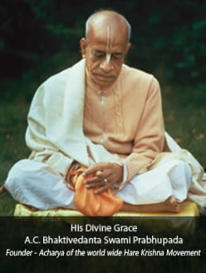

Hare Krishna, welcome please sign up to chant and hear the holy name, Haribol!
Continue with Google

Slide 2
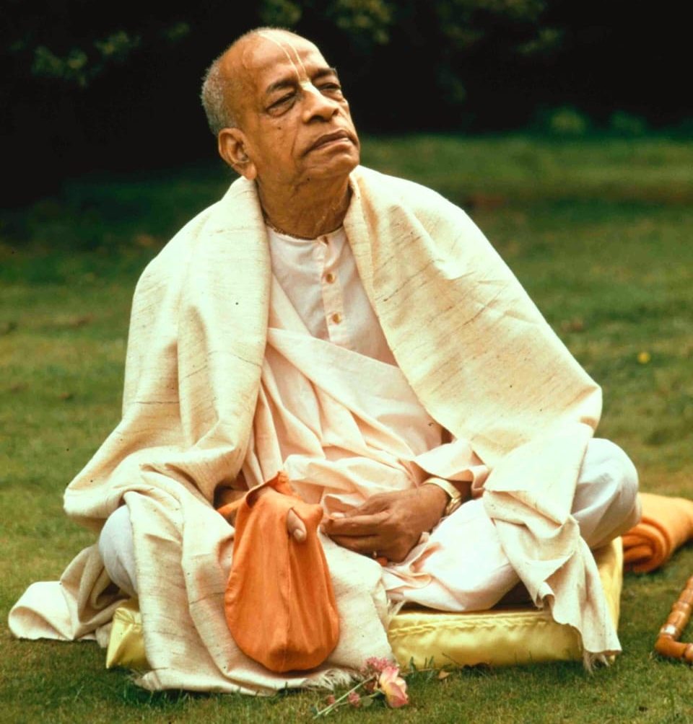
Dedicated to His Divine Grace
A.C.Bhaktivedanta Swami Prabhupada
Founder - Acharya of the world wide Hare Krishna Movement
“
By Srila Prabupada,
The name Krishna and the Supreme Person Krishna are non-different.
Therefore, if one concentrates his mind on hearing and chanting Hare Krishan, The Same Result is Achieved."
Hare Krishna, Welcome to
Chant and Hear App.
Please sign up to experience and enhance your chanting skills.
Continue with Google

Slide 3
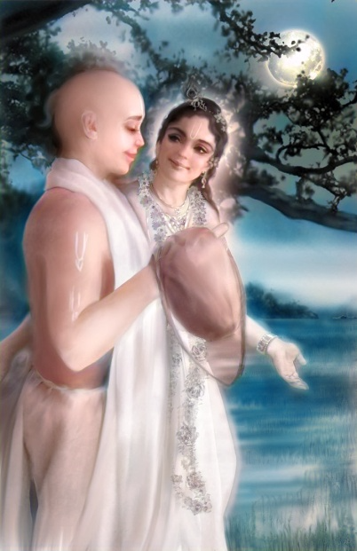
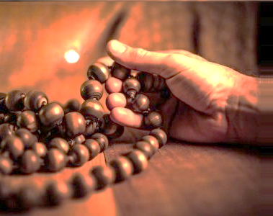
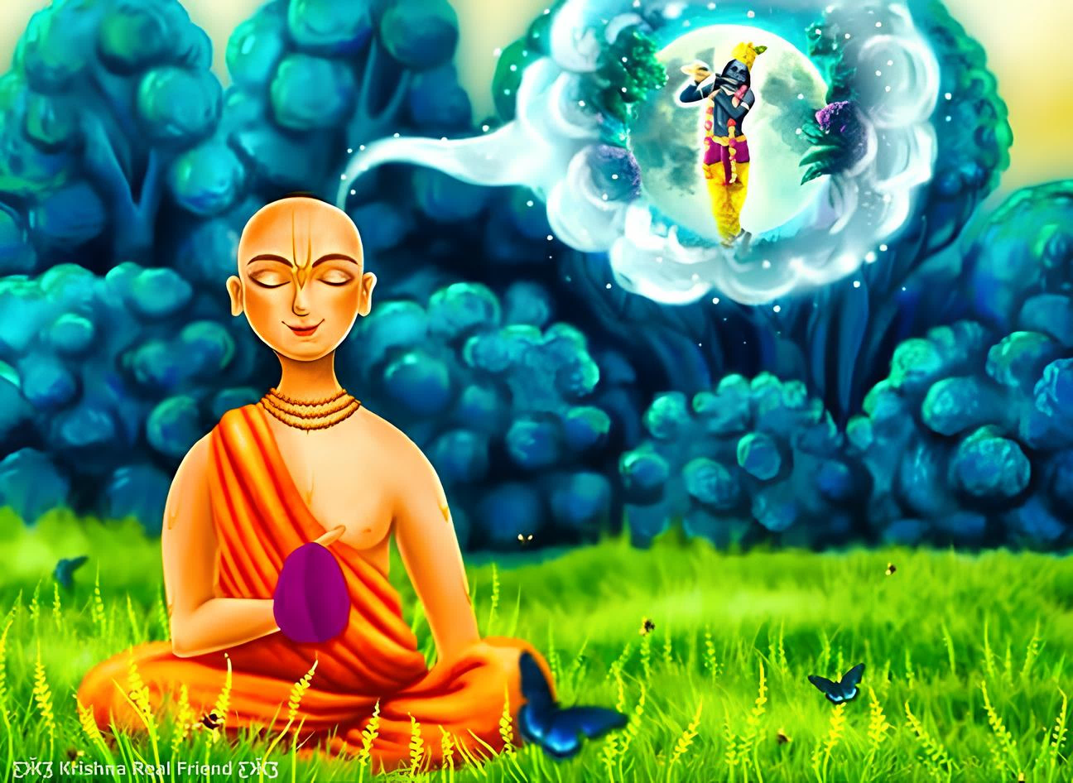



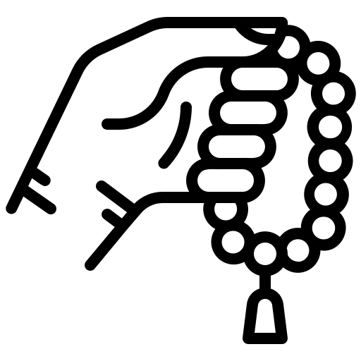
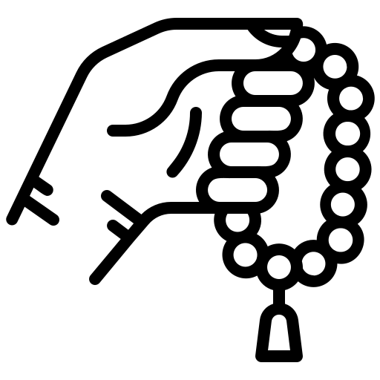
Mindful Japa
Heartful Japa
Soulful Japa
Dedicate to His Divine Grace
A.C.Bhaktivedanta Swami Prabhupada
Founder - Acharya of the world wide Hare Krishna Movement
Coming
Coming
soon
soon

Slide 4
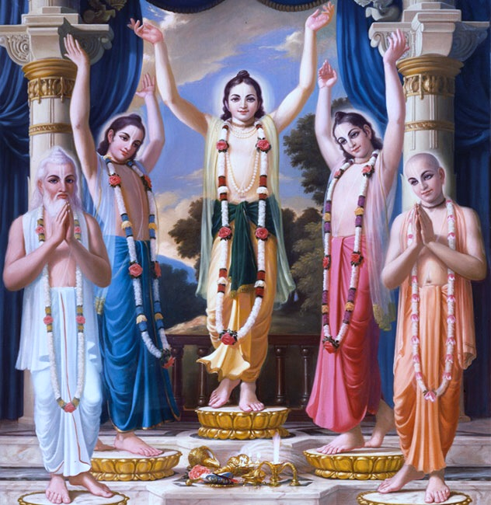

Slide 5



Hare Krishna, <user name>
Feel the presence of Krishna every bead
Hare Krishna, <user name>
Feel the presence of Krishna every bead
Level Selection
Progress card
Level Selection
Progress card
Today’s mala progress
4
Rounds Completed
198
Total heard count
Acquired stars
Mindful japa progress
6890
Total heard count
34
Across days
B
Bronze medal

Slide 6

01
Heard
67
Time take
06:18 min
Hare Krishna, <user name>
Feel the presence of Krishna every bead
02
Heard
45
Time take
07:38 min
Level Selection
Progress card
78
03
Heard
Time take
05:45 min
Today’s mala progress
04
Heard
35
4
Rounds Completed
198
Total heard count
Time take
08:05 min
Acquired stars
05
Heard
90
Time take
05:56 min
Mindful japa progress
6890
Total heard count
34
Across days
B
06
Heard
78
Bronze medal
06:23 min
Time take

Slide 7

22-Dec-2024
Hare Krishna, <user name>
Feel the presence of Krishna every bead
4
Rounds Completed
198
Total heard count
Acquired stars
Level Selection
Progress card
21-Dec-2024
9
Rounds Completed
304
Total heard count
Acquired stars
Today’s mala progress
4
Rounds Completed
198
Total heard count
20-Dec-2024
Acquired stars
6
Rounds Completed
230
Total heard count
Acquired stars
Mindful japa progress
21-Dec-2024
6890
Total heard count
34
Across days
B
12
Rounds Completed
398
Total heard count
Bronze medal
Acquired stars

Slide 8
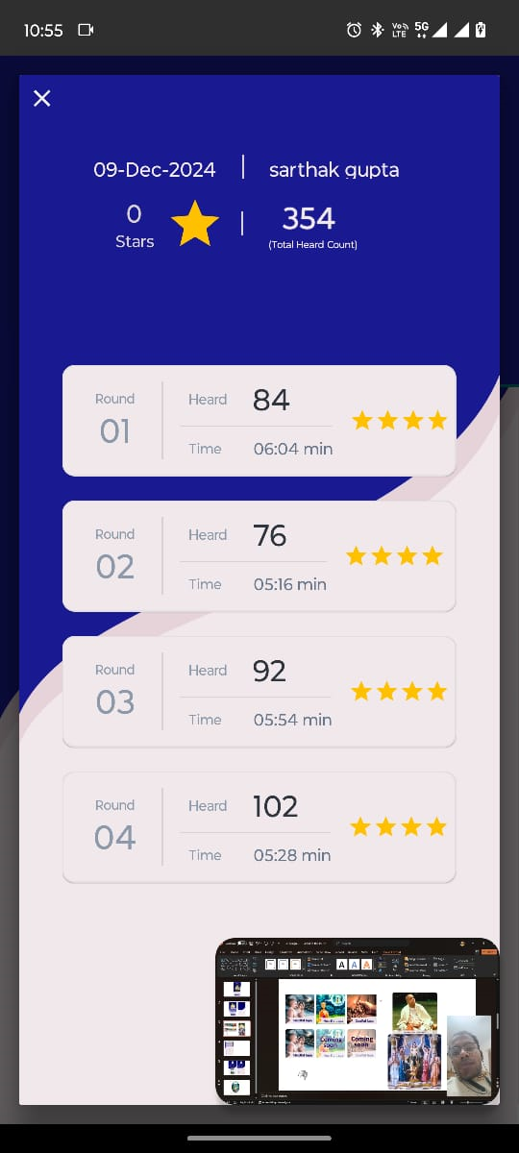

Slide 9
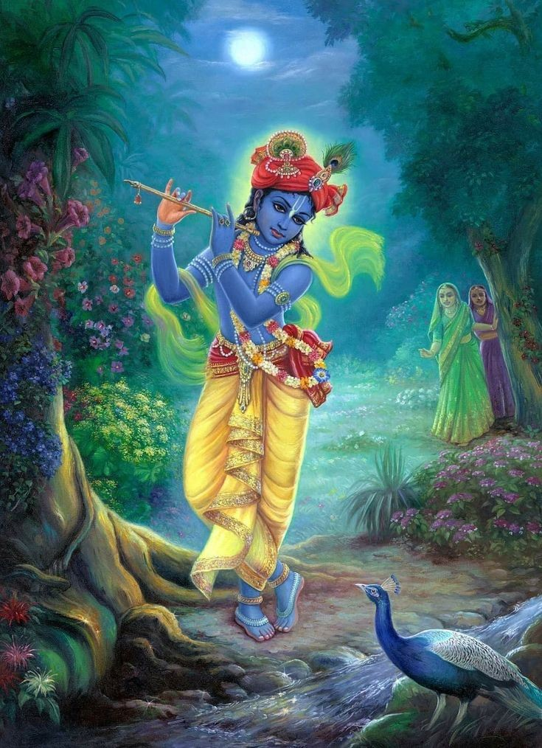
I am the nama

Slide 10


Hear and tap
Chant & Hear

Slide 11
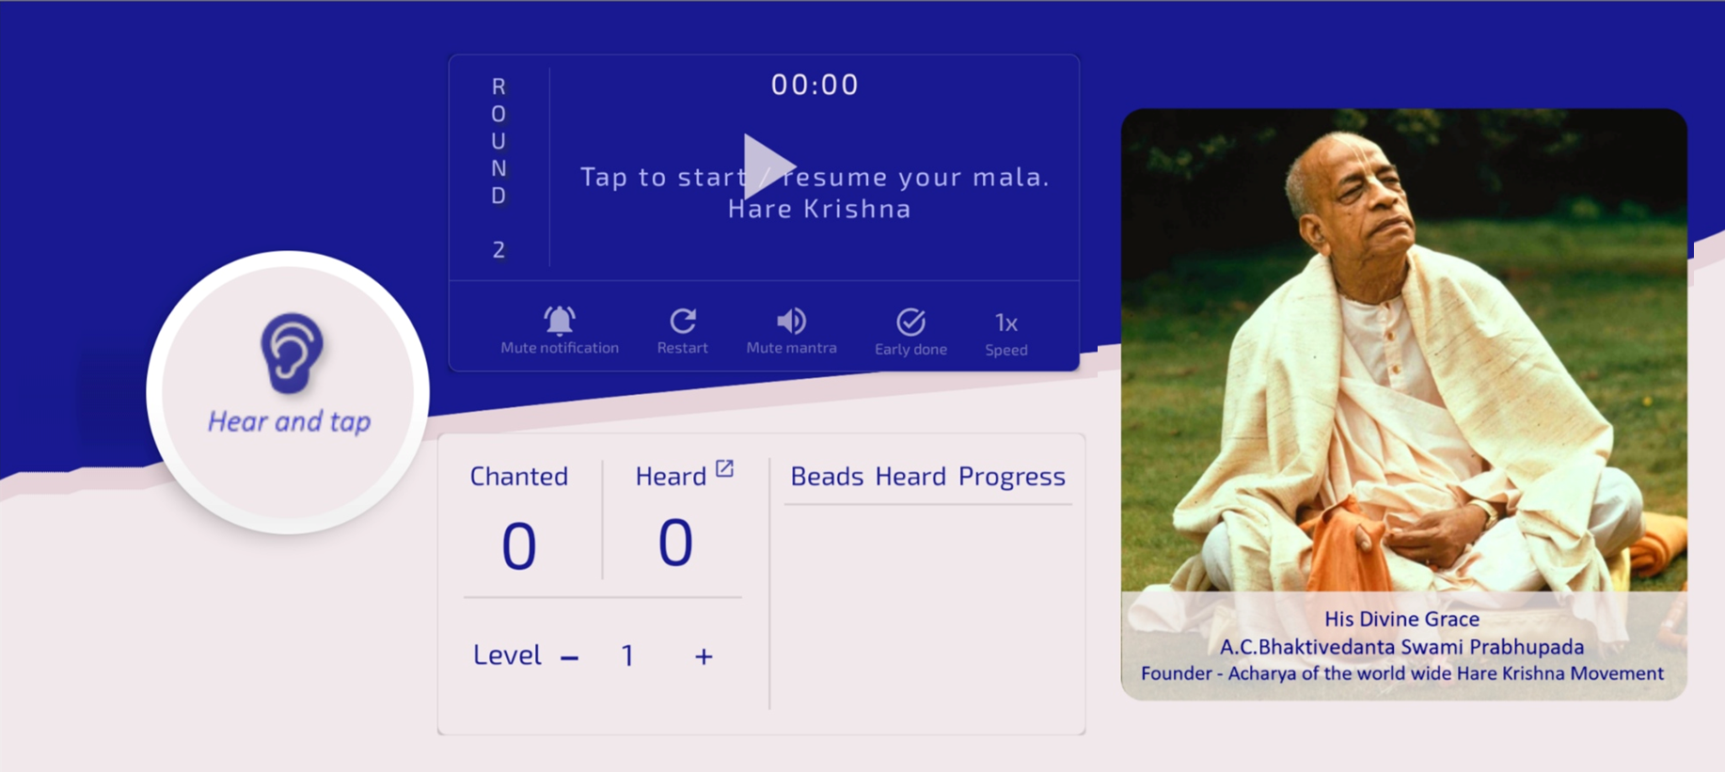
R1: 91
R1: 91
R2: 54
R3: 78
R4: 101
R5: 89
R6: 96
R7: 25
R8: 67

Slide 12
Round | Count
01
98
02
18
03
47
04
76
05
84
06
34
07
54
08
108

Slide 13
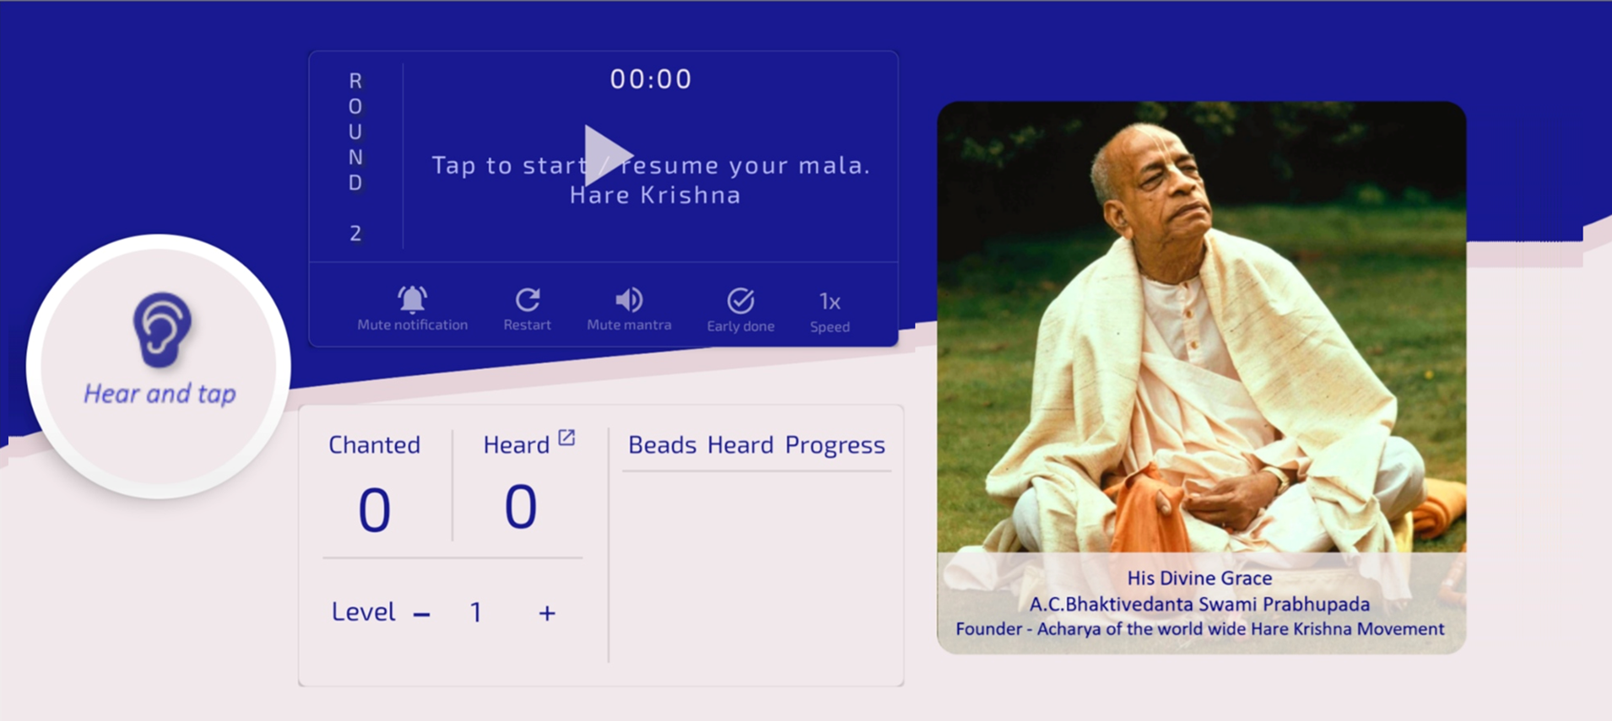
98
01
Round | Count
01
98
02
18
03
47
04
76
05
84
06
34
07
54
08
108

Slide 14
98
01
05
097
Total heard
098
Count | Round
01
098
02
078
03
045
04
093
05
097

Slide 15
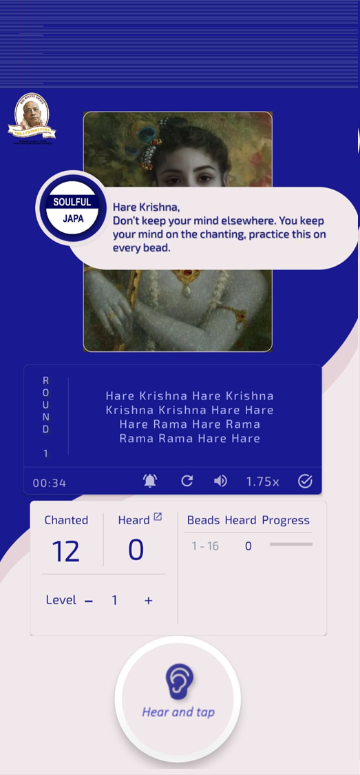
08
07
06
05
04
Heard | Round
54
34
84
76
108

Slide 16
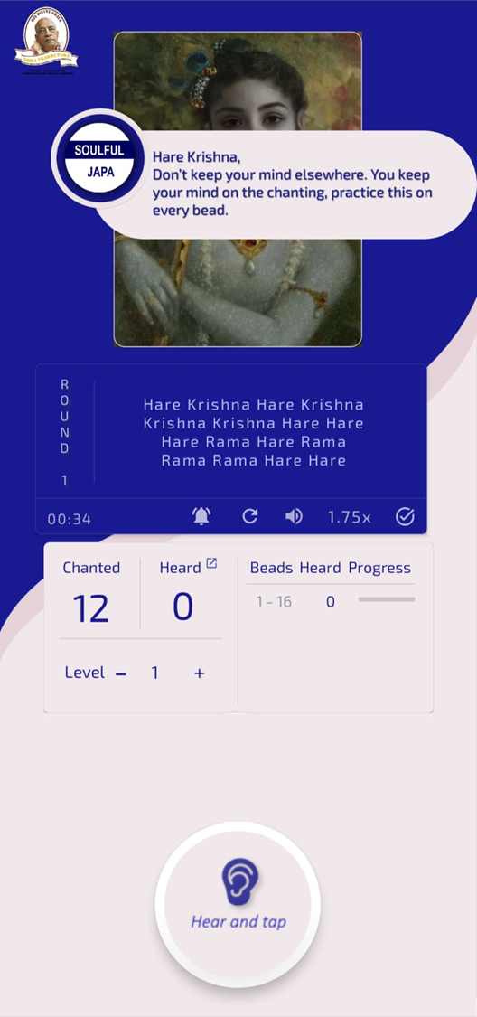
Summary progress
Total
Round
08
07
06
05
0000
Heard
108
54
34
84

Slide 17
Round
08
07
06
05
Heard
108
54
34
84
You have completed milestone, increase the Hearing level
Increase

